Slide 1
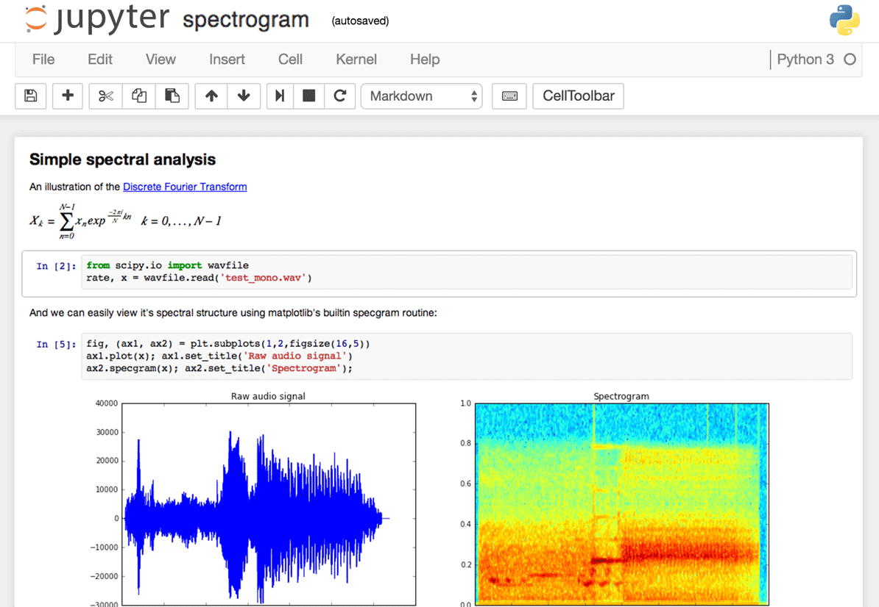
Anaconda &
Jupyter Notebook
src: https://www.dataquest.io/blog/content/images/interface-screenshot.png

Slide 2
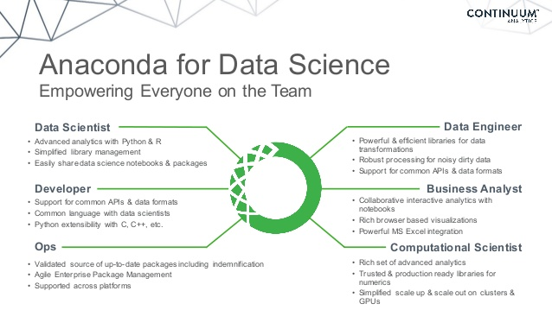
Anaconda
❑ Anaconda is an open source distribution of Python for
large-scale data processing
predictive analytics
scientific computing
Reference: https://en.wikipedia.org/wiki/Anaconda_(Python_distribution)
Src: https://image.slidesharecdn.com/201511distributedsystemswebinar-151112174420-lva1-app6891/95/distributed-computing-on-your-cluster-with-anaconda-webinar-2015-7-638.jpg?cb=1455728952

Slide 3
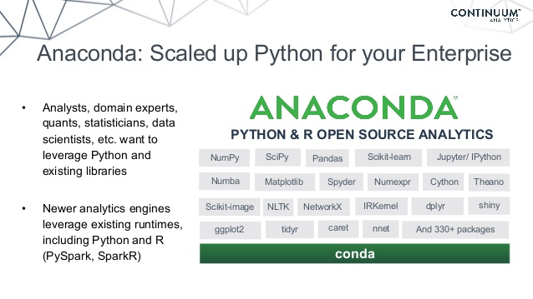
Anaconda
❑ Anaconda includes…
Latest version of Python
Useful libraries and packages for scientific computing (NumPy, Pandas, Scikit-learn, …)
Python development environment (Jupyter Notebook, qtconsole, Spyder, …)
Package management tool (conda, pip, …)
❑ So you don’t have to install them one by one!
Src: https://image.slidesharecdn.com/201511distributedsystemswebinar-151112174420-lva1-app6891/95/distributed-computing-on-your-cluster-with-anaconda-webinar-2015-11-638.jpg?cb=1455728952

Slide 4
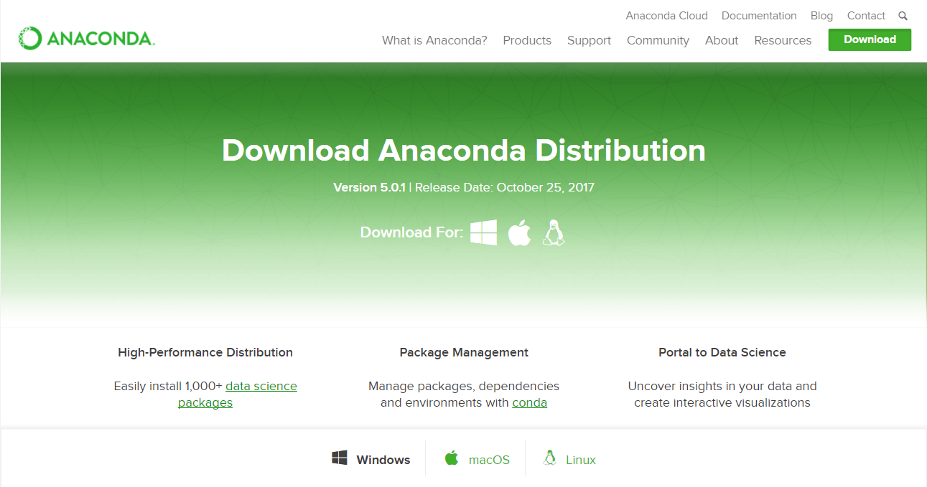
Installation
❑ Download latest version of Anaconda and install
https://www.anaconda.com/download/
❑ TIP: It is useful to remember where Anaconda is installed (i.e., directory)
In some cases, one has to access the directory (e.g., for path settings)
Src: https://www.anaconda.com/download/

Slide 5
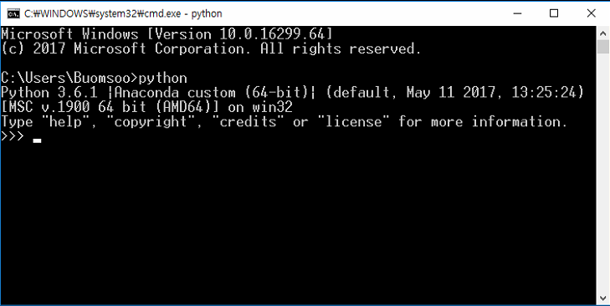
Installation
❑ If installation is finished, run Python for sanity check
In cmd or terminal, type “python” and press Enter
If it is not working properly, check path environment variable
Src: http://cloudpeermedia.com/wp-content/uploads/2015/12/figure-1.jpg

Slide 6
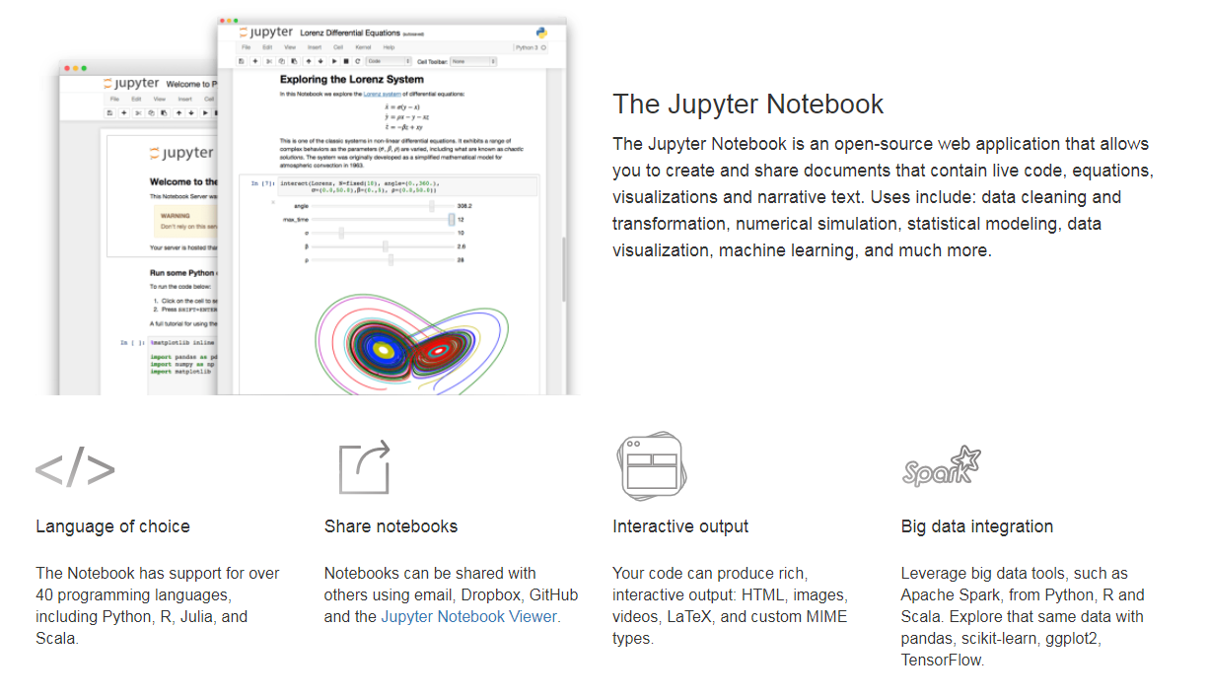
Jupyter Notebook
❑ Jupyter Notebook is an open-source web application that allows creating and sharing documents that contain live code, equations, visualizations, and narrative text
Jupyter Notebook is included in latest version of Anaconda
Reference: http://jupyter.org/
Src: http://jupyter.org/

Slide 7
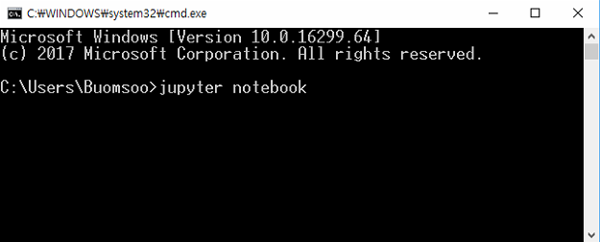
Jupyter Notebook
❑ Running Jupyter Notebook
In cmd or terminal, type “jupyter notebook” and press enter

Slide 8
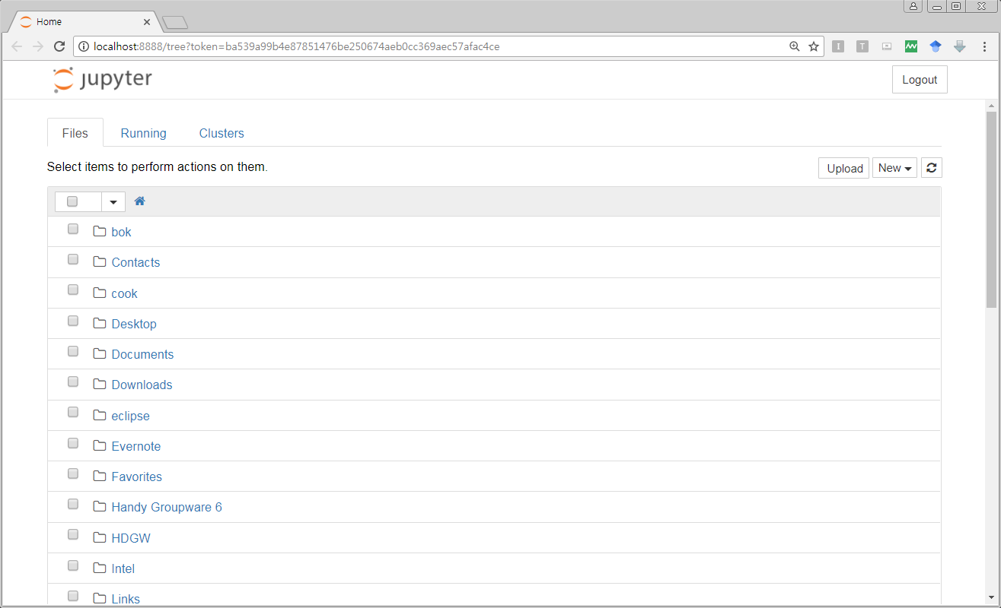
Jupyter Notebook
❑ Running Jupyter Notebook
In default browser (Chrome, Safari, Explorer, …), elements in home directory of your PC will be displayed

Slide 9
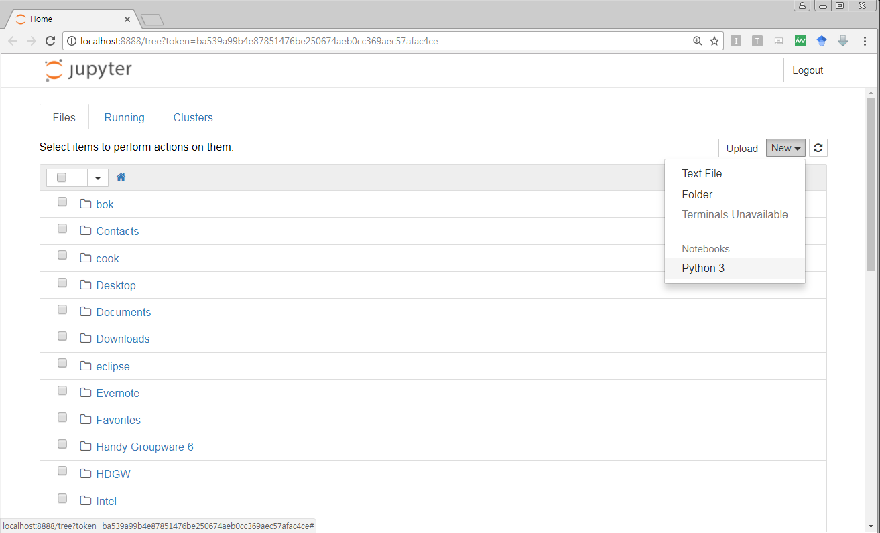
Jupyter Notebook
❑ Creating Jupyter Notebook document
Select [New] button in upper right section, and press [Python 3]

Slide 10
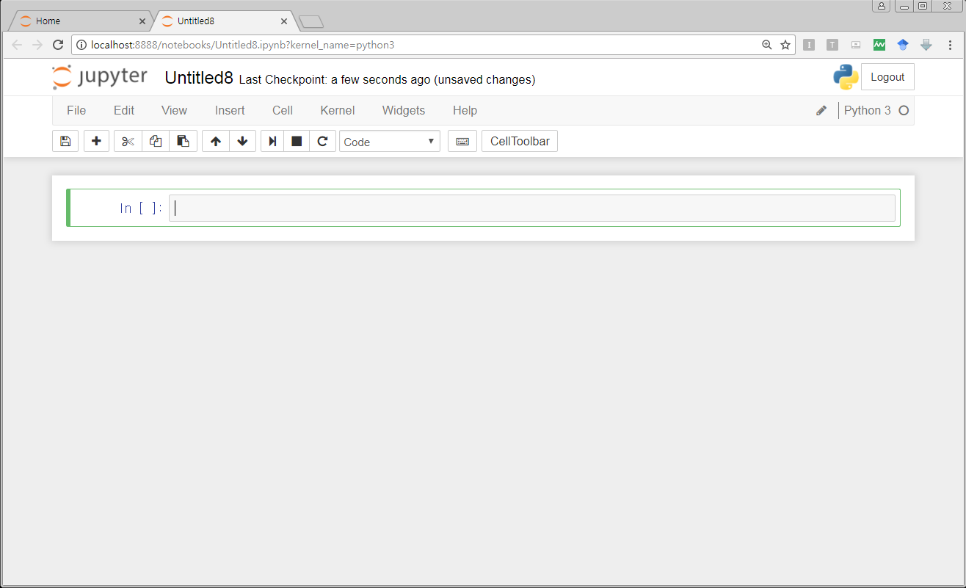
Jupyter Notebook
❑ Creating Jupyter Notebook document
Untitled Jupyter Notebook document will be created
File extension of Jupyter Notebook is “.ipynb”

Slide 11
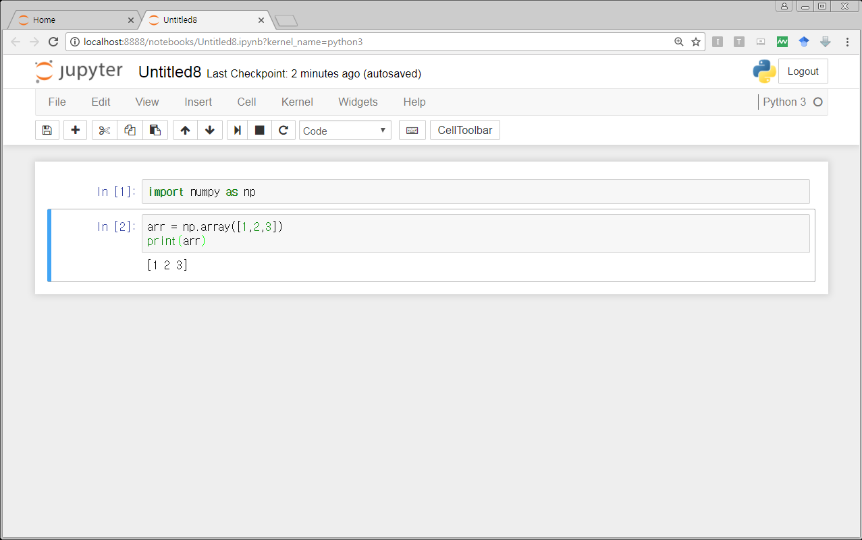
Jupyter Notebook
❑ Creating Jupyter Notebook document
Now you could create code blocks and type code lines and run them!

Slide 12
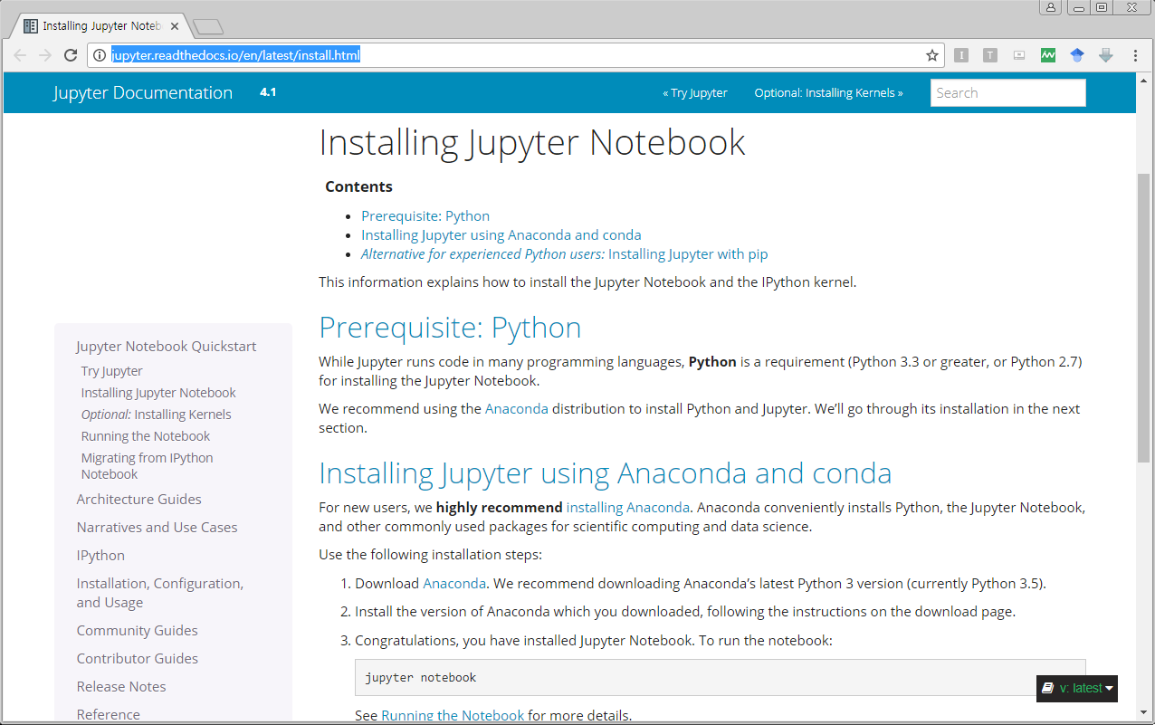
Jupyter Notebook
❑ Jupyter Notebook Documentation
For more information, refer to Jupyter Notebook official documentation
http://jupyter.readthedocs.io/en/latest/install.html

